Slide 1
EC772 Final Presentation
Multicycle CPU with Approximate ALU

Slide 2
Outline
Introduction
Goals
Implementation (Original and approximate CPU)
Encounter
Original CPU results
Approx CPU results
Images- RTL, memory layout, place and route, clock distribution
Virtuoso

Slide 3
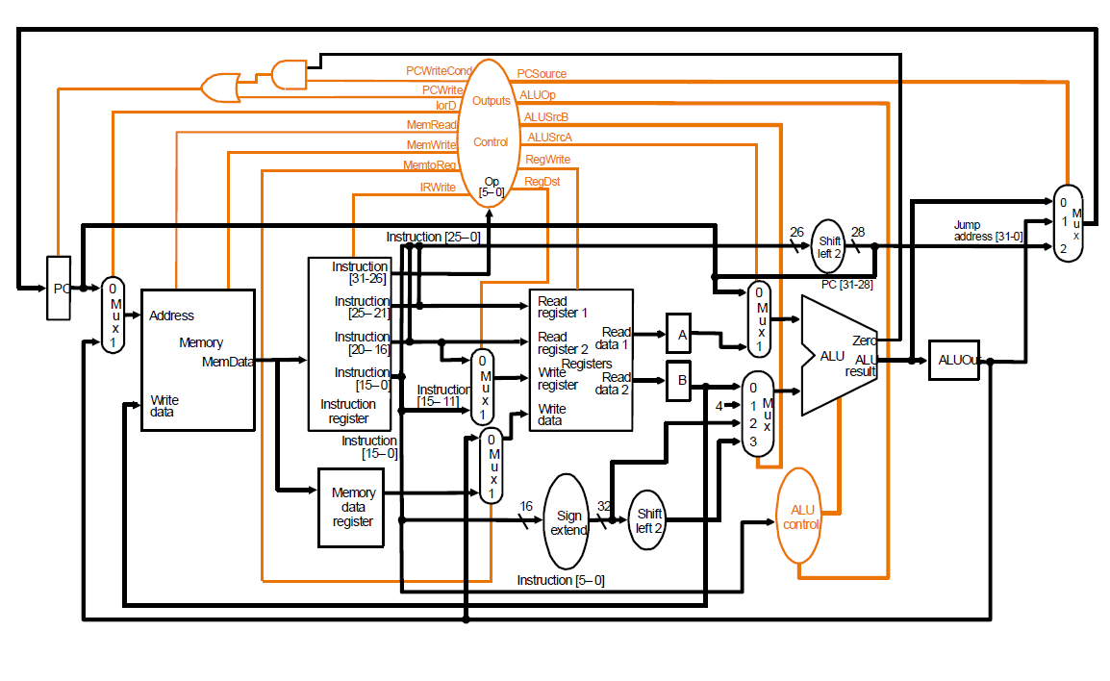
Introduction

Slide 4
Goals
Stretch goals
16-bit Multi-cycle CPU
Reconfigurable approximation block
Floating point multiplication

Slide 5
Introduction - Approximation
100000011111111
x 100000011111111
10000100000000111111000000001
=(276856321)₁₀
1000000
x1000000
1000000000000 0000000000000000
=(268435456)₁₀
Worst case loss: (276856321-268435456)/276856321 = ~3% (for losing 8 bits out of 16 bit signed integer multiplication)

Slide 6
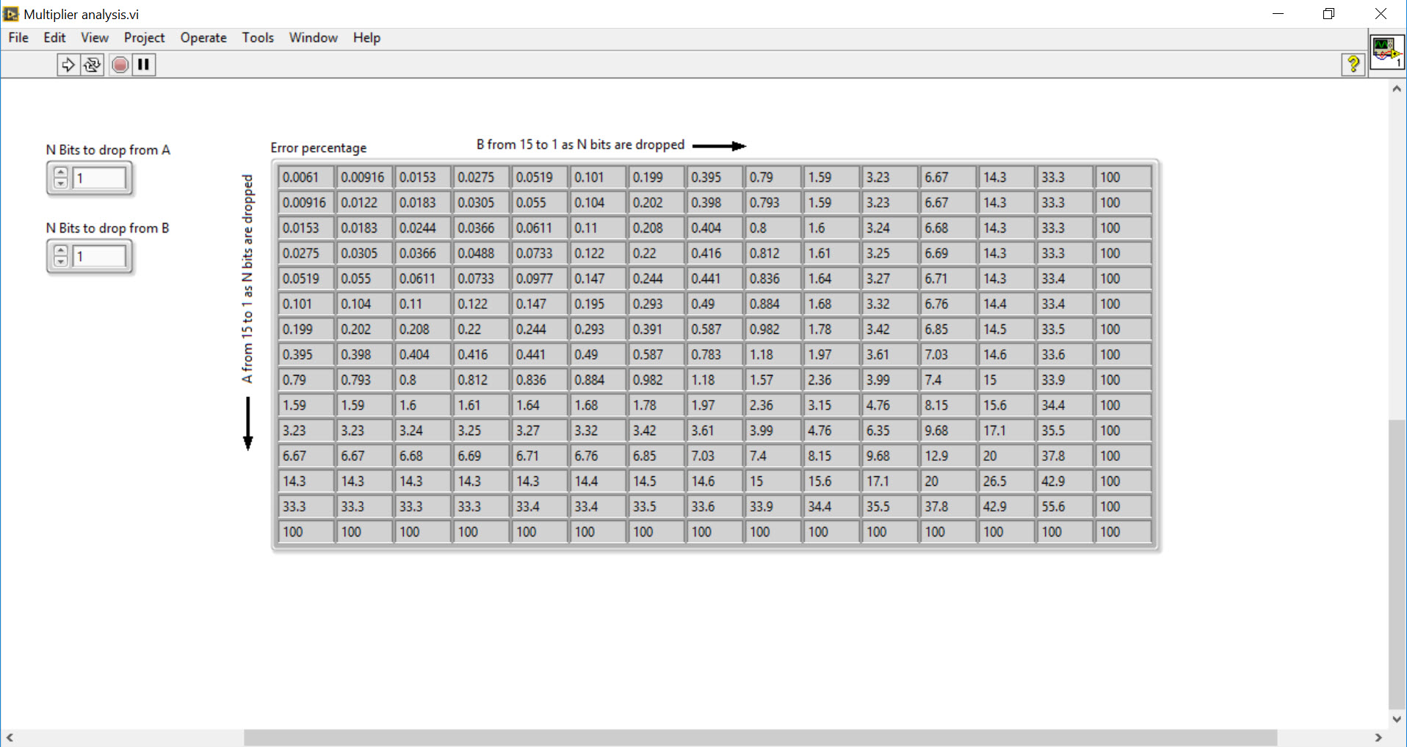
Implementation
Approximation calculations

Slide 7
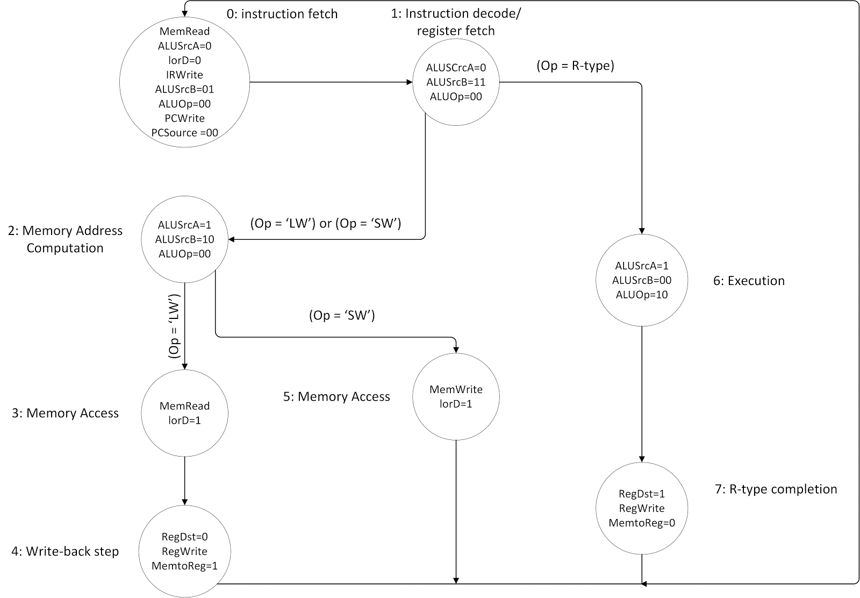
Implementation
Original CPU design

Slide 8
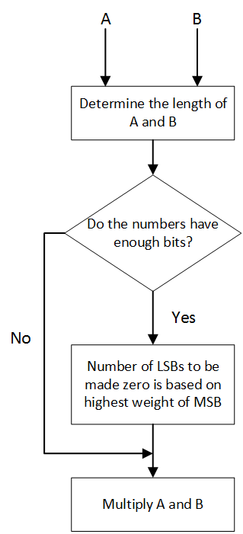
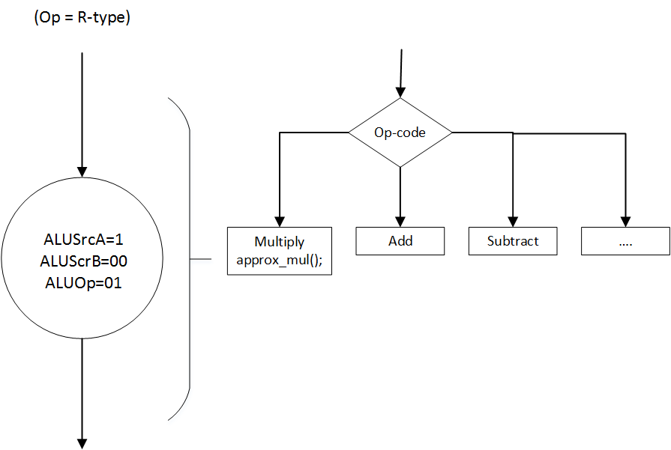
Implementation
CPU design with approximation

Slide 9
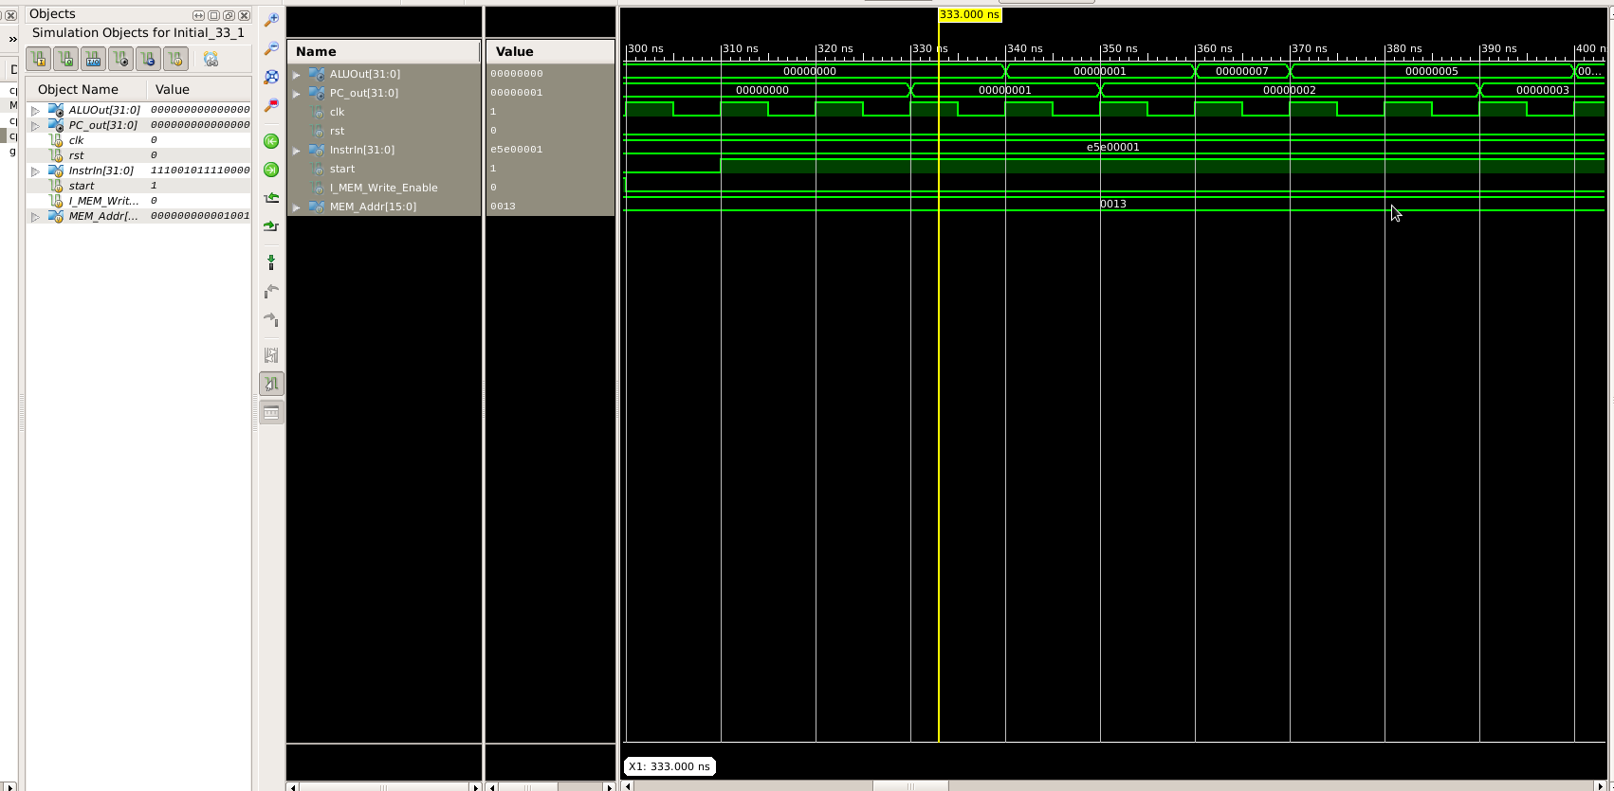
Xilinx ISE simulation results
Regular cpu

Slide 10
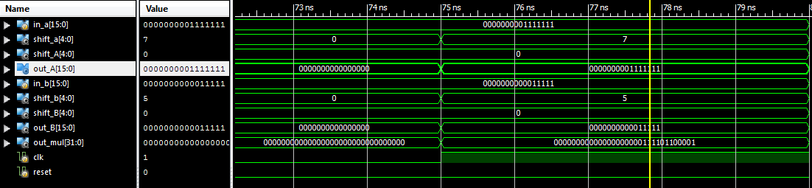
Xilinx ISE simulation results
Approx cpu

Slide 11
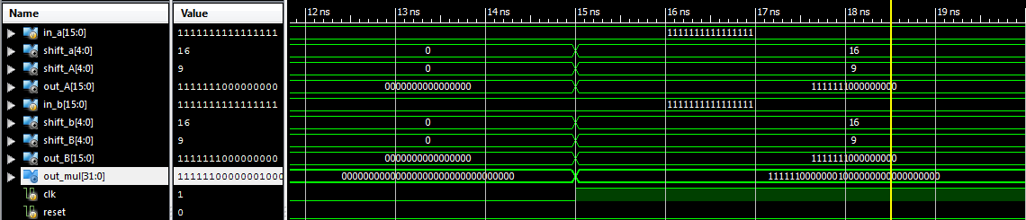
Xilinx ISE simulation results
Approx cpu

Slide 12
RTL results
Regular cpu - 1000ps clock - 1GHz
Approx cpu - 1200ps clock - 0.769 GHz

Slide 13
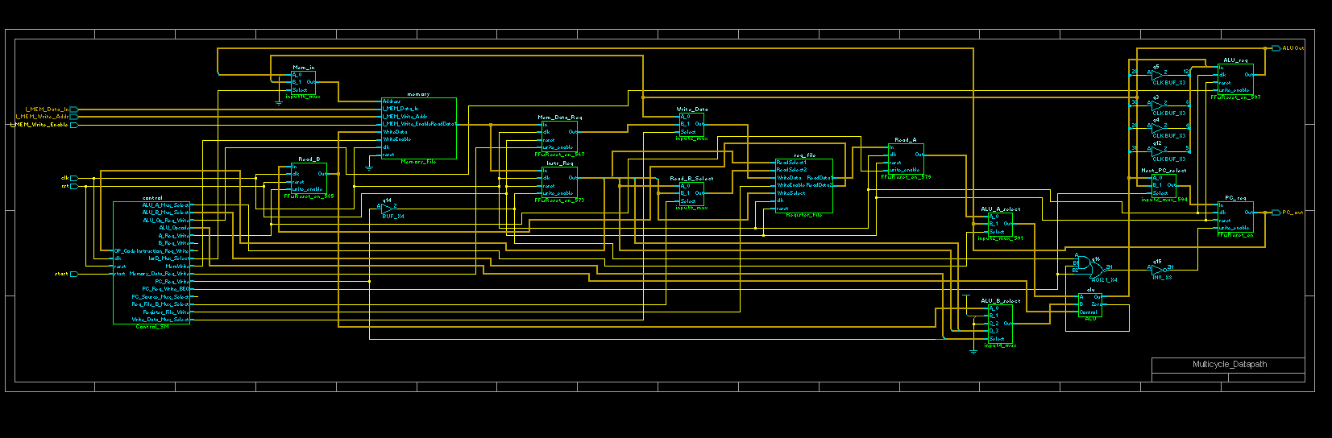
RTL results
CPU-regular

Slide 14
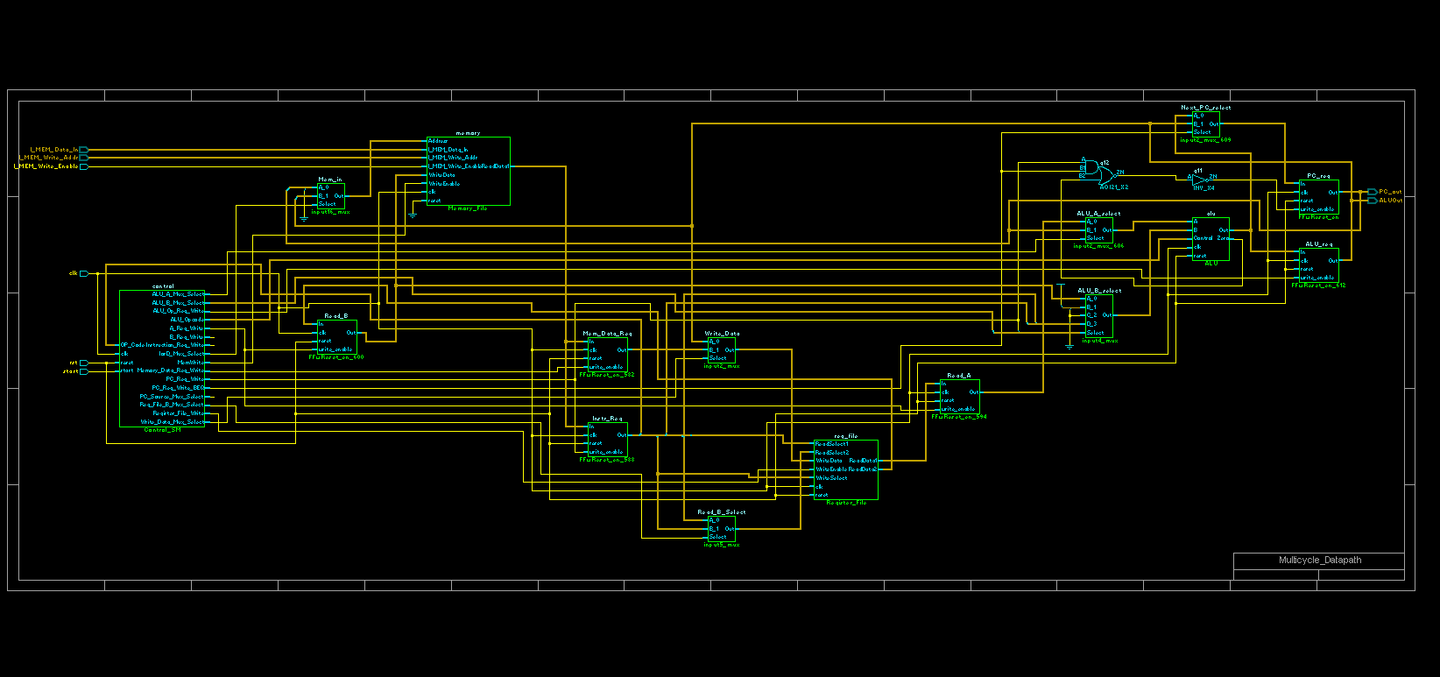
RTL results
CPU-approx

Slide 15
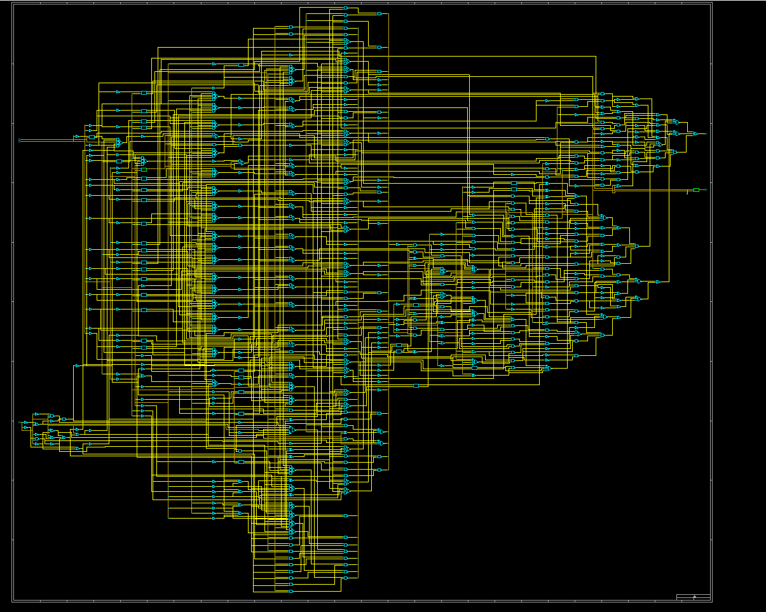
RTL results
ALU-regular

Slide 16
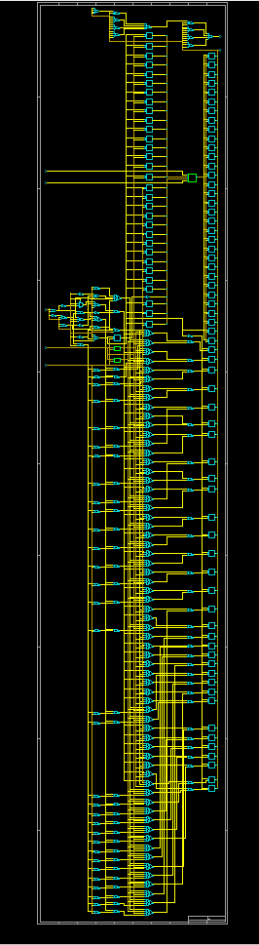
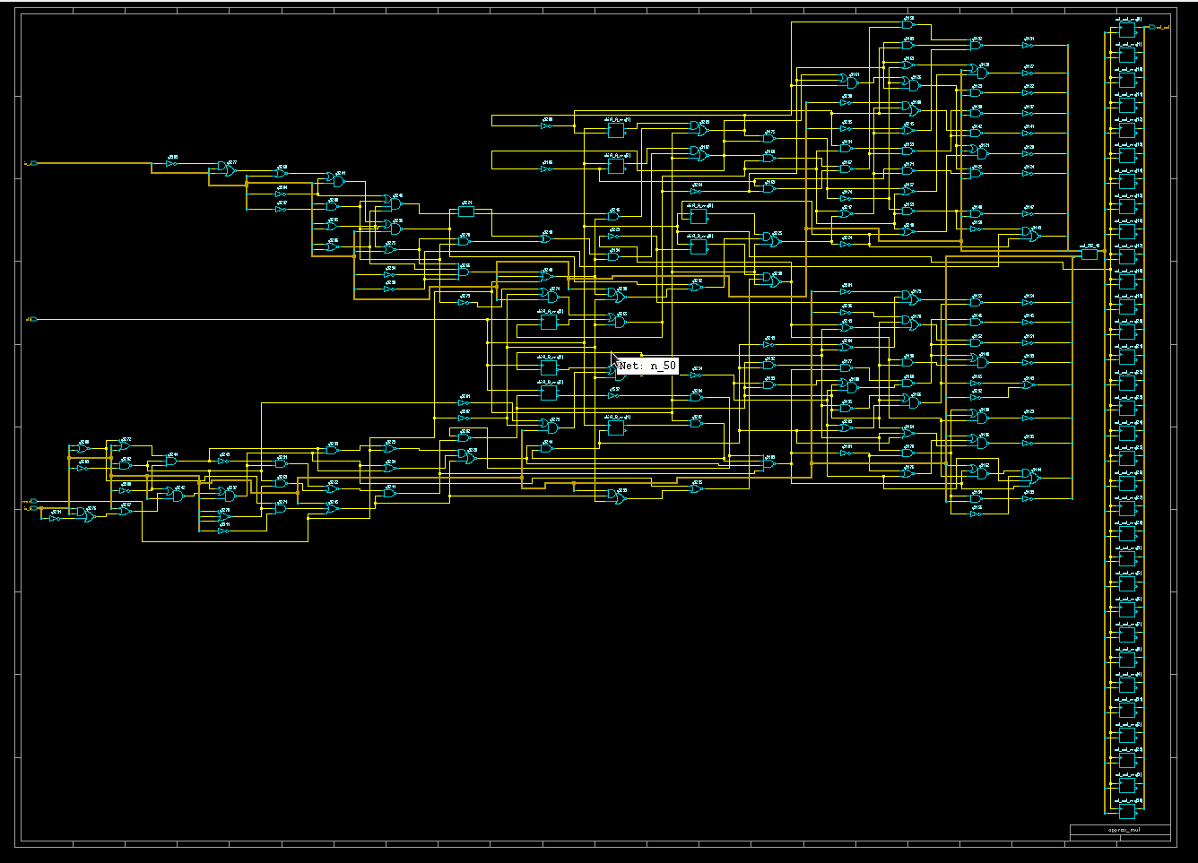
RTL results
ALU-approx

Slide 17
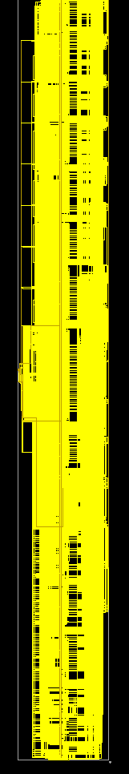
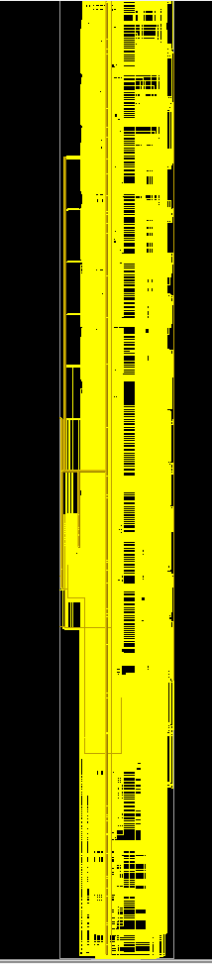
RTL results
Memory - regular and approx

Slide 18
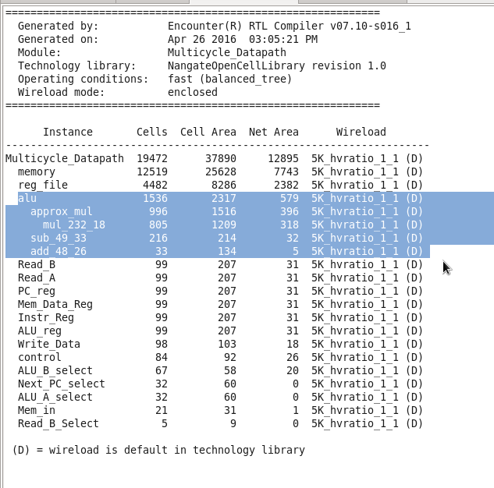
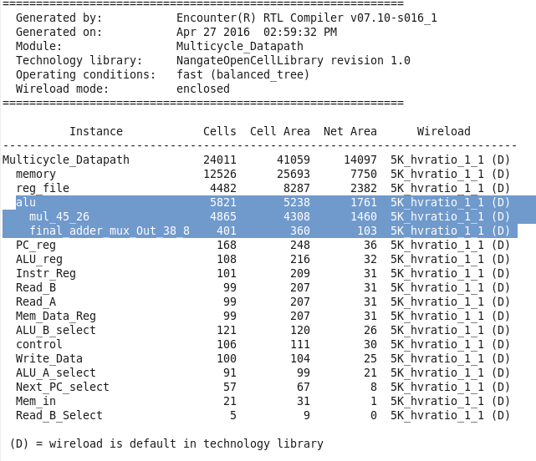
RTL results
Approx Cell Area Log-78849 Reg Cell Area Log-86780

Slide 19
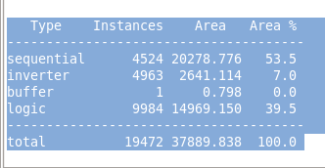
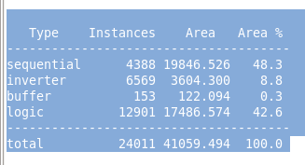
RTL results
Approx Gate Area Log Reg Gate Area Log

Slide 20
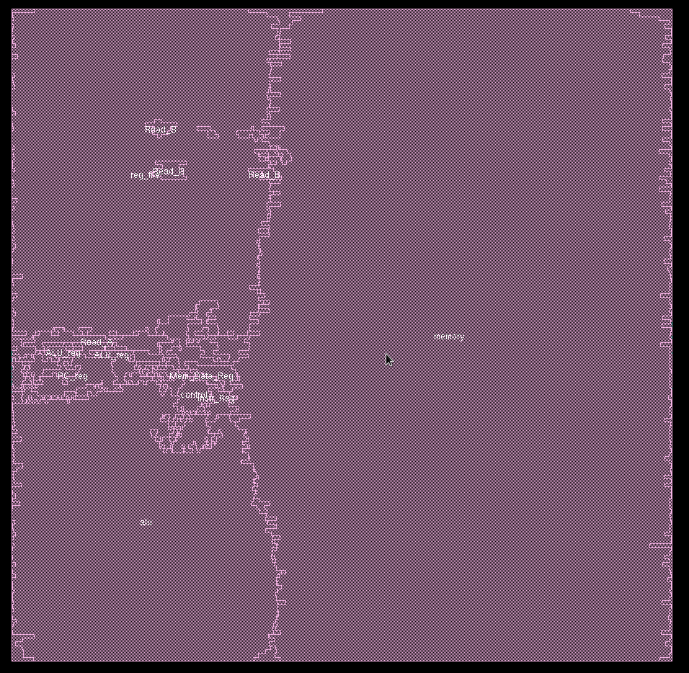
Encounter results
Amoeba - regular CPU

Slide 21
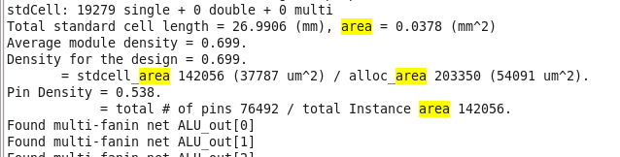
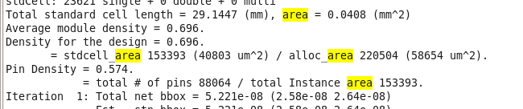
Encounter results
Approx Gate Area Log Reg Gate Area Log

Slide 22
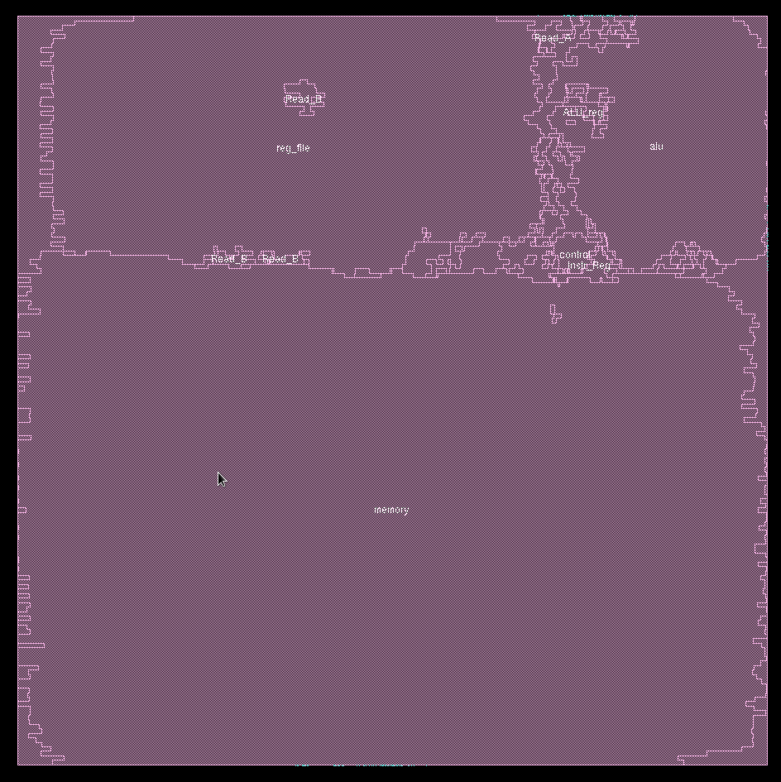
Encounter results
Amoeba - approx CPU

Slide 23
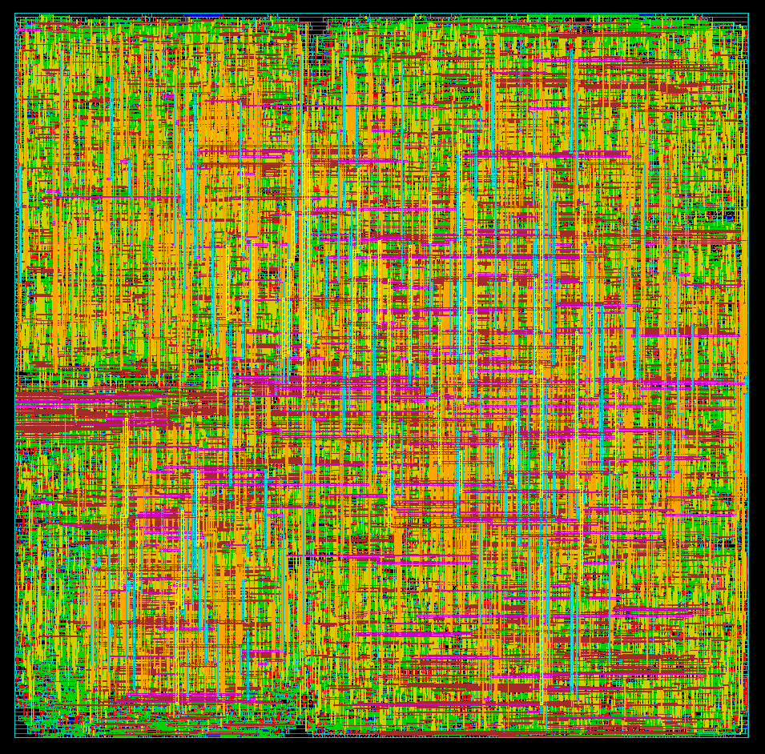
Encounter results
Globaldetailroute - regular CPU

Slide 24
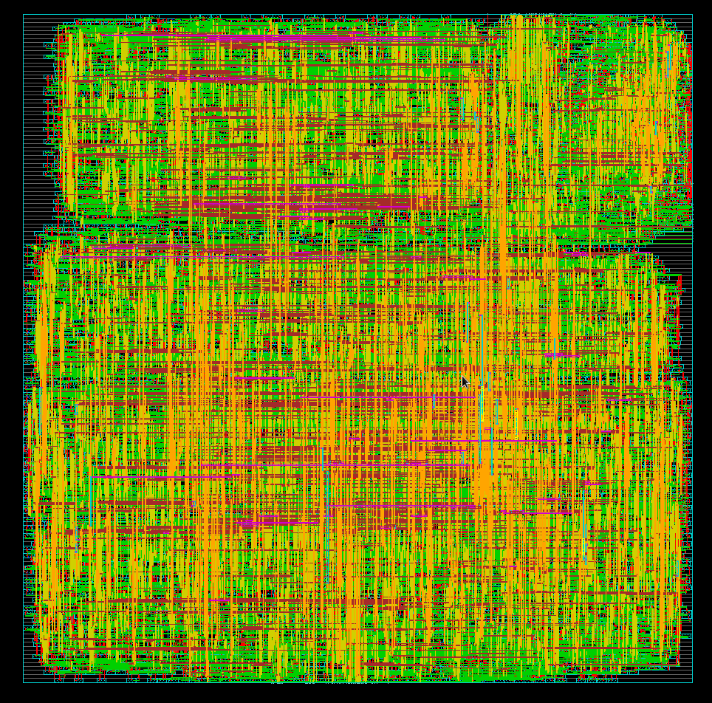
Encounter results
Globaldetailroute - approx CPU

Slide 25
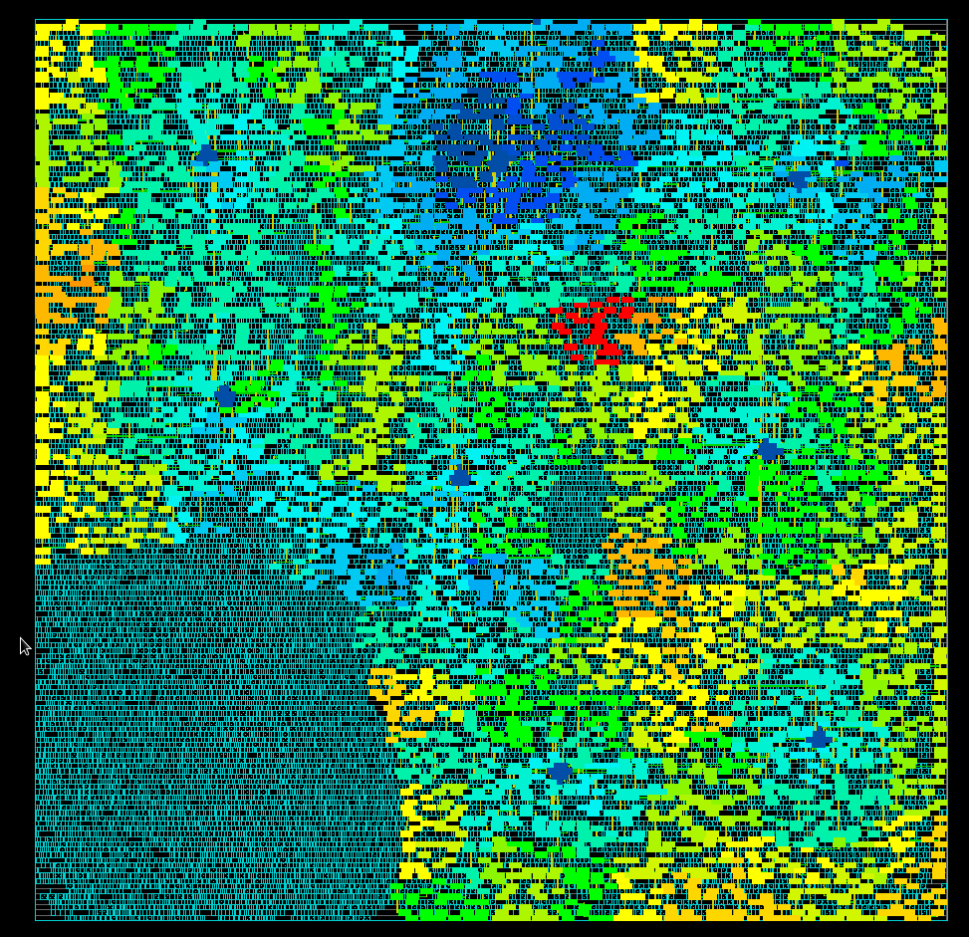
Encounter results
Clock phase delay - Regular CPU

Slide 26
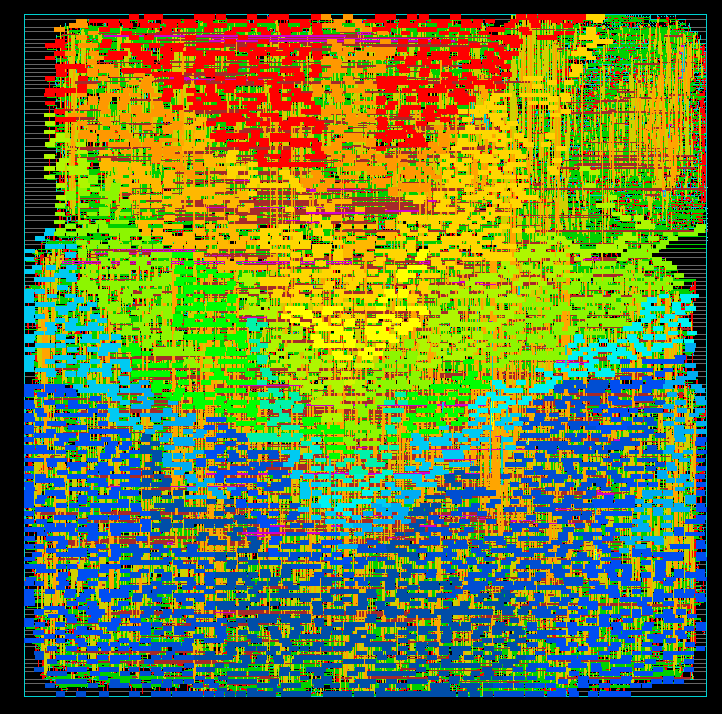
Encounter results
Clock phase delay - approx CPU

Slide 27
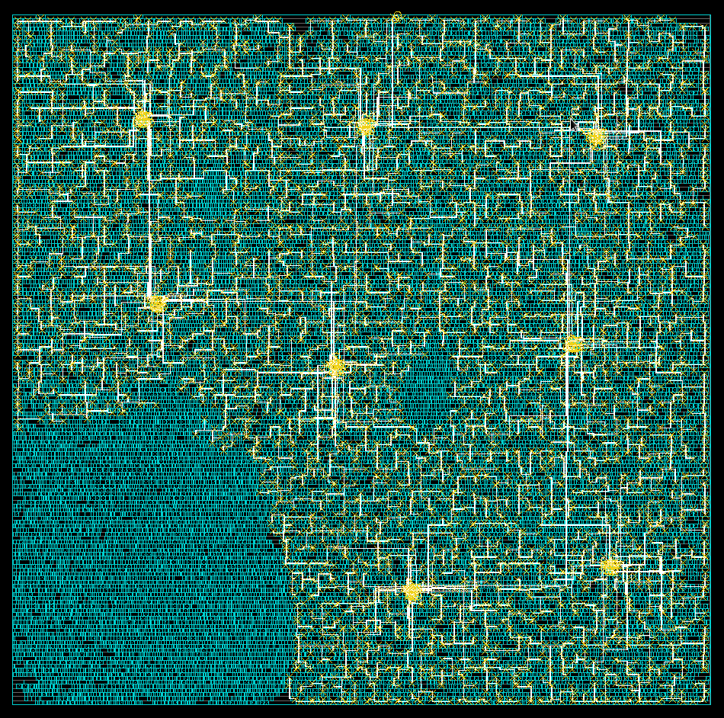
Encounter results
Clock tree - regular CPU

Slide 28
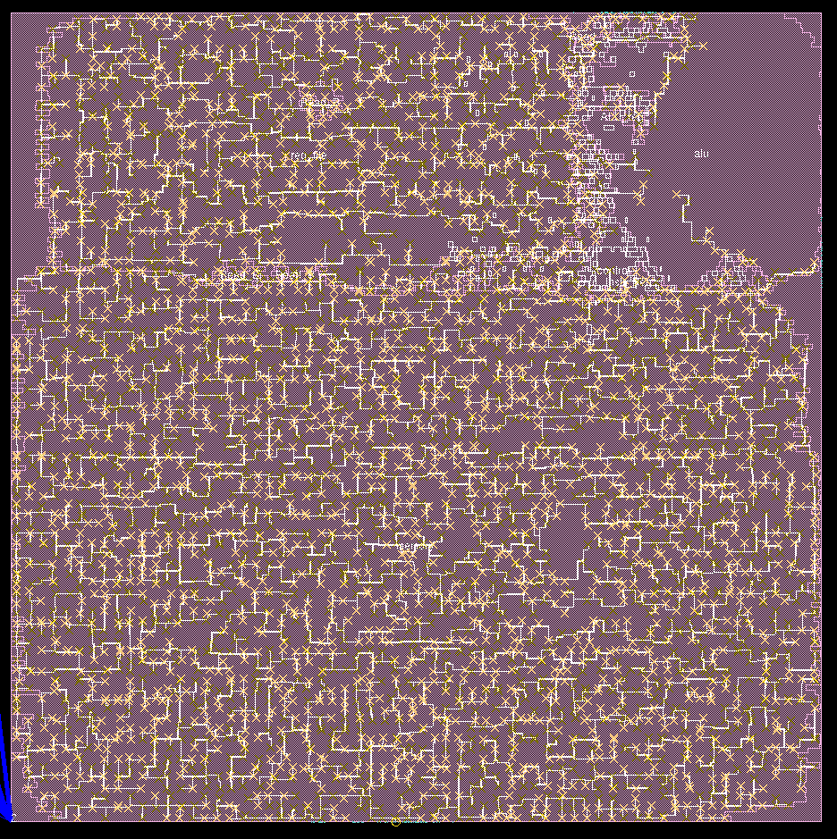
Encounter results
Clock tree - approx CPU

Slide 29
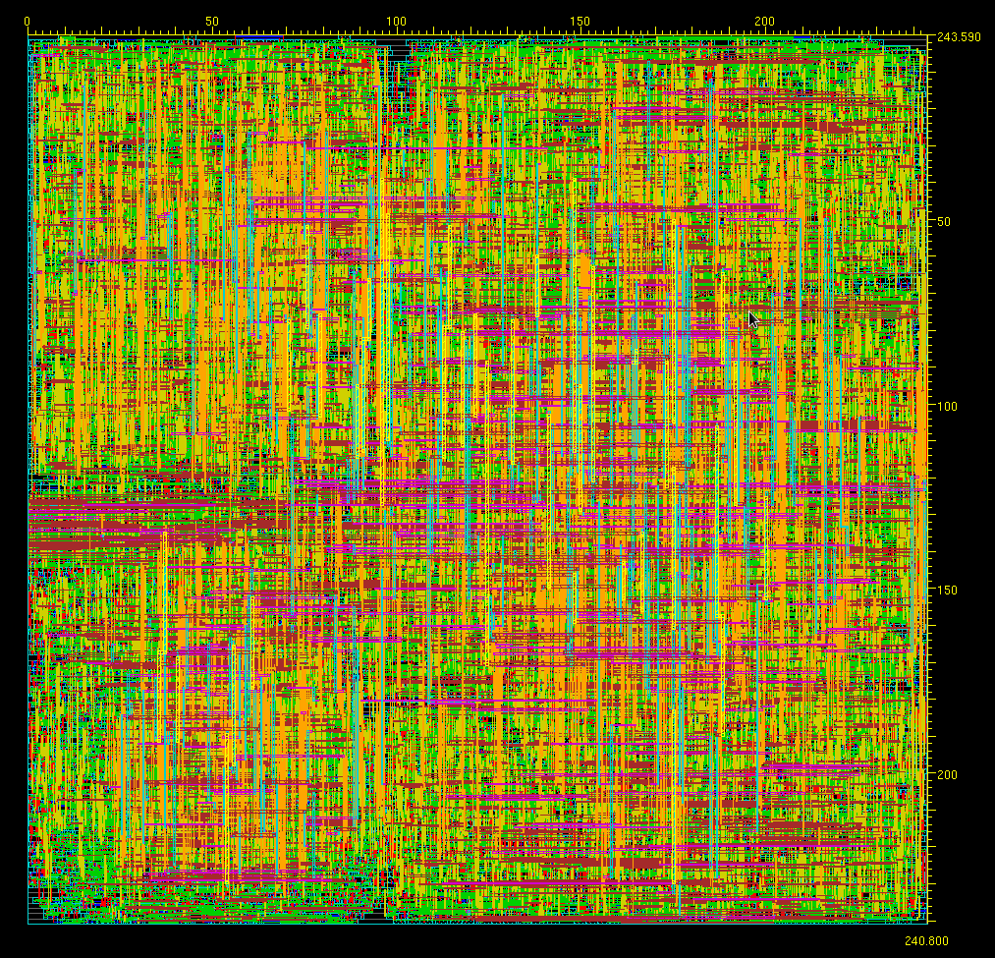
Encounter Results
CPU Size:
243.590μm x 240.800μm
= 0.58mm²

Slide 30
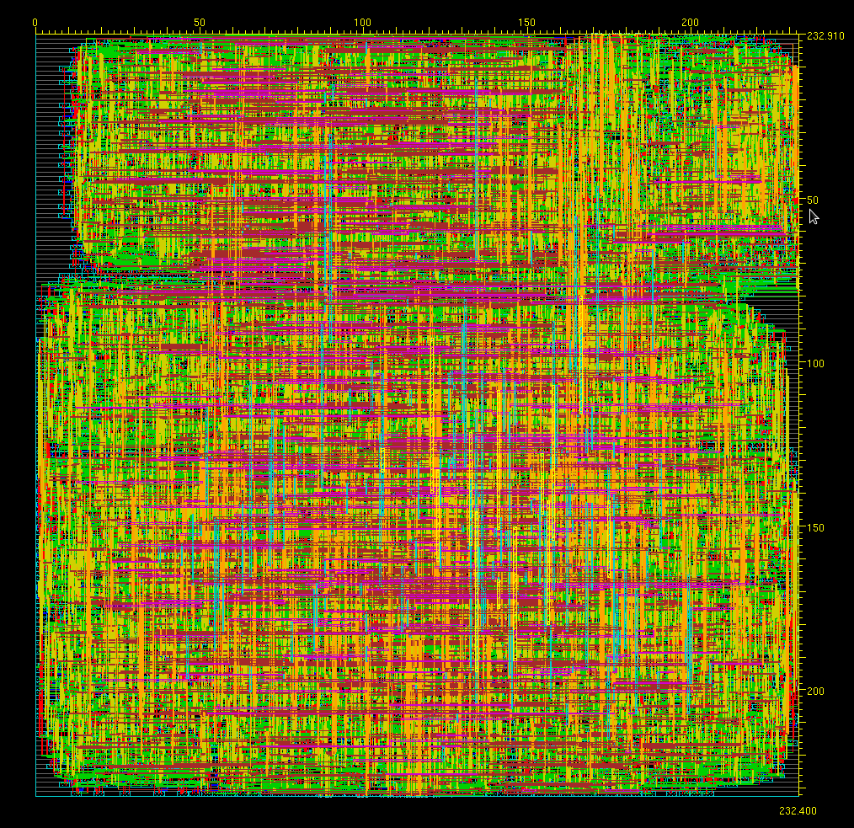
Encounter Results
Approx CPU size:
232.910μm x 232.400μm
= 0.54mm²

Slide 31
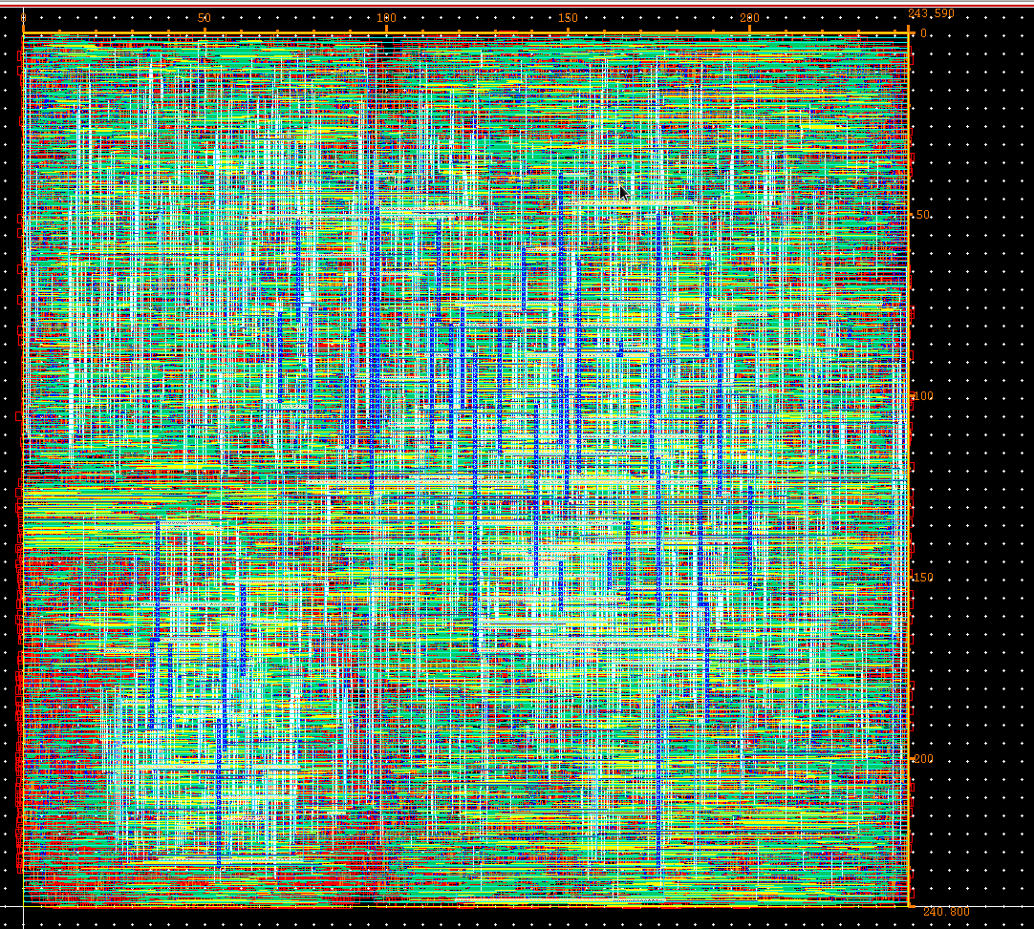
Virtuoso results
Regular cpu
243.59μm x 240.8μm
= .58mm²

Slide 32
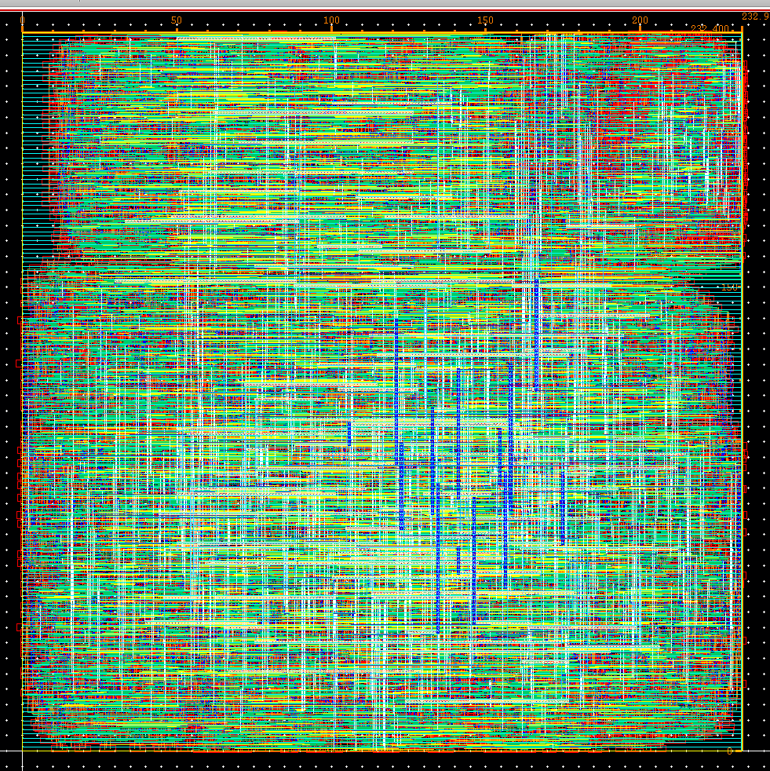
Virtuoso results
Approx cpu
232.9μm x 232.4μm = .54mm²

Slide 33
Thank You
-Darrin Ginoza
-Mahesh Bhutada
-Omkar Nagendra
-Kiran Vishal

